Slide 1
Sequence
Notes:
LO: I can use logical reasoning to explain how some simple algorithms work.

Slide 2
Algorithm
Sequence
Sprite
Notes:
Introduce students to key vocabulary for this lesson:
Algorithm: An unambiguous procedure or precise step-by-step guide to solve a problem or achieve a particular objective.
Sequence: “When we sequence things, we arrange them in a particular order. Sequence-based algorithms are made from a precise set of instructions.”
Sprite: These are the images that perform actions in a visual program. Examples are the penguin, rocket etc. Note however, that the backgrounds are also sprites.

Slide 3
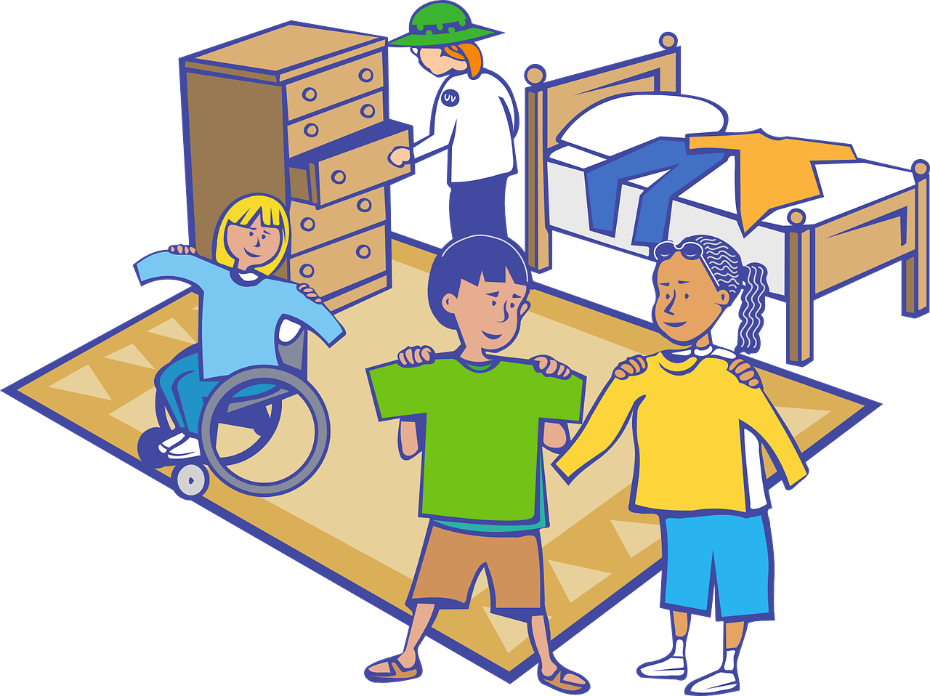
Notes:
When we sequence things, we arrange them in a order. Sequence-based algorithms are made from a precise set of instructions.
Students will have seen and had experience of many types of sequence, sometimes the order of the sequence is important, sometimes less so.
Examples shown are:
Alphabet (has to be in the right order)
Recipe (doesn’t have to always be in order)
Brushing teeth (has to be in the right order)
Getting dressed (order isn’t as important since some people might put their socks on before trousers etc)

Slide 4
5, 10, 15, 20, 25, 30, ?
10, 22, 46, 94, 190, ?
1, 3, 7, 15, 31, 63, ?
Notes:
Ask your students to explore their logical reasoning skills and their knowledge of sequence with these numbers patterns.
For each sequence students need to be able to say:
Sequence (what comes next?)
Explain the rule (algorithm)
Explain how you worked it out.
You may want to change to numbers to fit the ability of your class.
Answers:
35 (add five to each number).
382 (double the number plus 2).
127 (add the subsequent number to the number shown).

Slide 5
A sequence is when we arrange something in a particular order. Sequence-based algorithms are made from a precise set of instructions.
Notes:
Explain to students about the importance of sequence in computing/coding.
In sequence-based algorithms, such as a recipe to bake a cake, the order of many (though not all) of the steps is crucial. Similarly, most programming languages are based on a series of statements to sequentially process. The outcome of a program will depend not only on the constituent commands but their order.

Slide 6
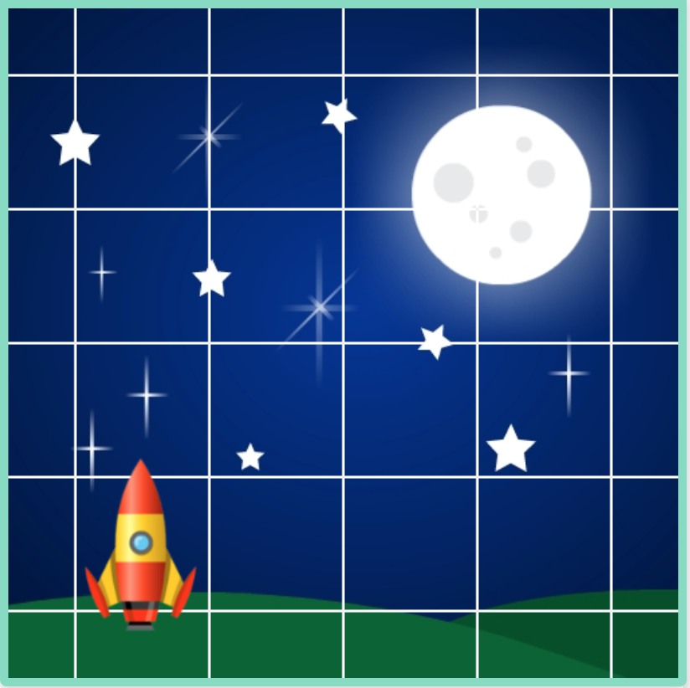
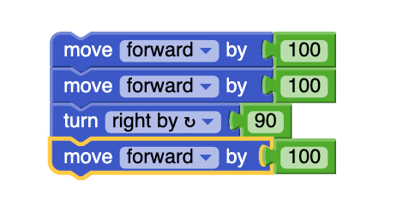
Notes:
Ask to read though the code this is called tracing code.
Can your students predict where the rocket will go for each block of code?
You will need to explain that the ’100’ equals the same size as one square of the grid.
You will also need to explain that 90 means a 90 degree/right/left turn.

Slide 7
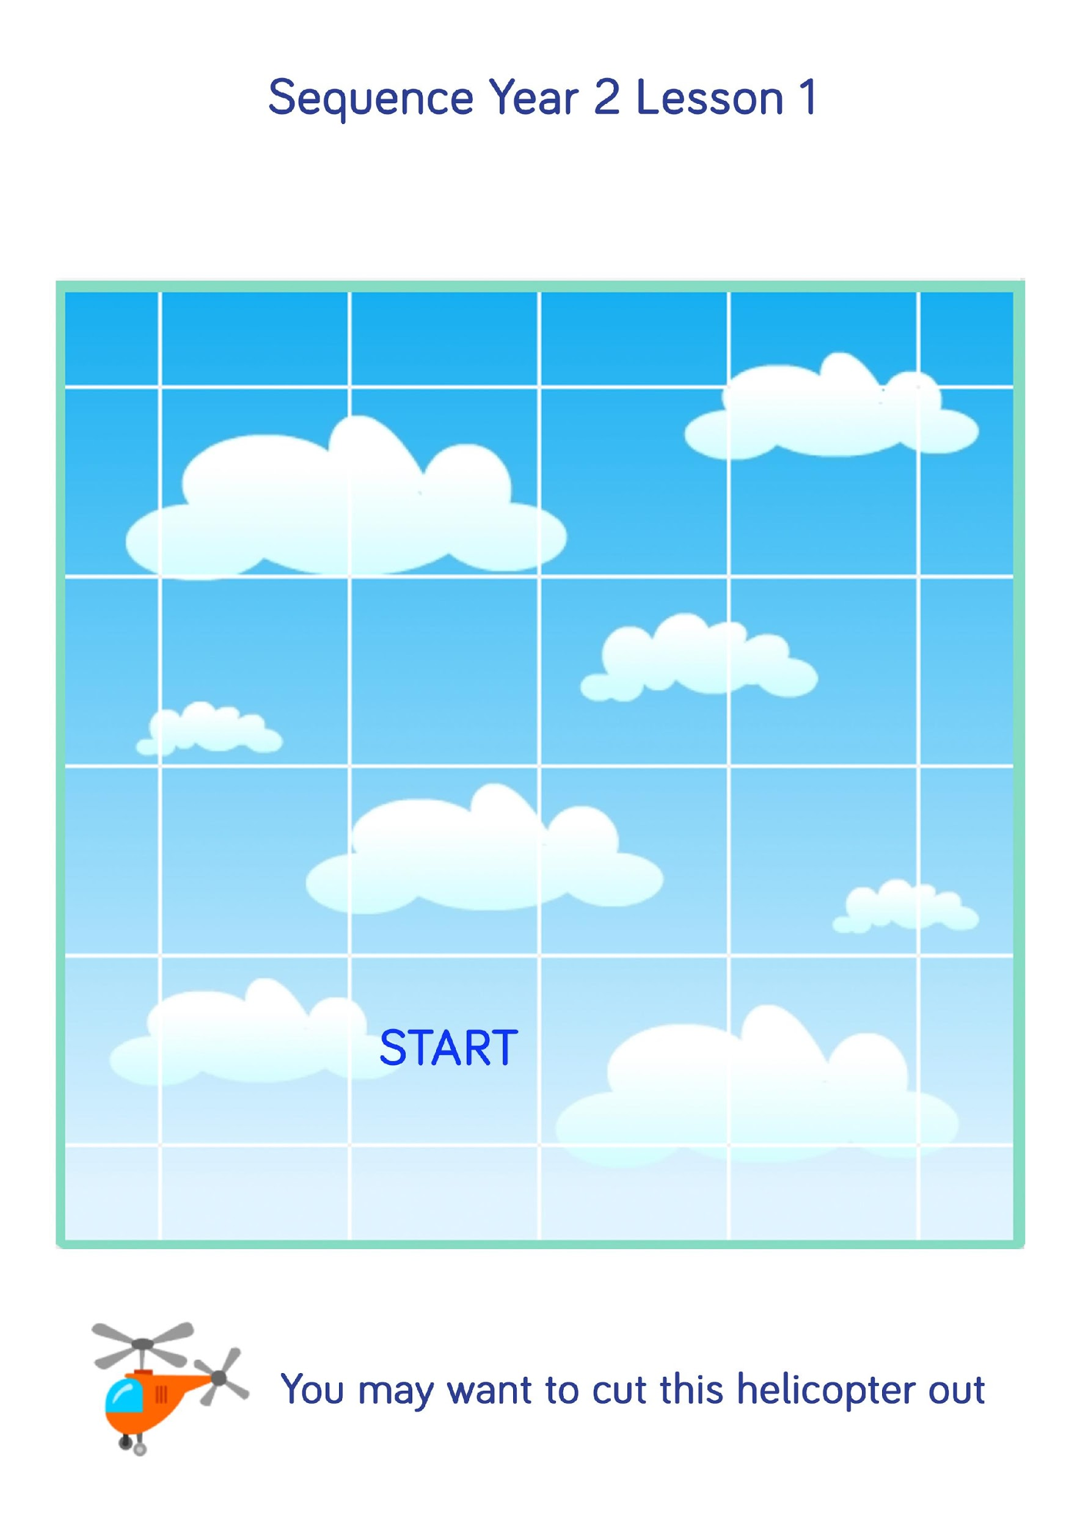
Notes:
Ask the class to read though the block coding code on the right; explain that when we ‘read’ coding we read downwards.
Can your students predict where the rocket will go?
Your students can either trace the code with a pencil or wipe board (if you have laminated it) or have a cut out rocket which they can physically move on the sheet.
You will need to explain that the ’100’ equals the same size as one square of the grid.
You were also need to explain that 90 means a 90 degree/right/left turn.

Slide 8
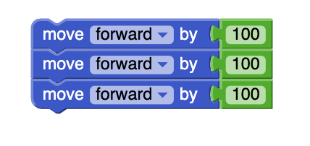
Notes:
Ask the class to read though the block coding code on the right; explain that when we ‘read’ coding we read downwards.
Can your students predict where the rocket will go?
Your students can either trace the code with a pencil or wipe board (if you have laminated it) or have a cut out rocket which they can physically move on the sheet.
You will need to explain that the ’100’ equals the same size as one square of the grid.
You were also need to explain that 90 means a 90 degree/right/left turn.

Slide 9
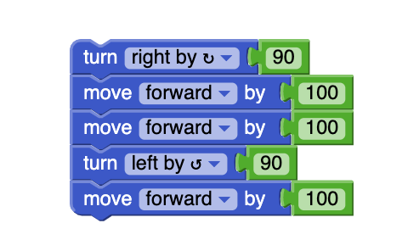
Notes:
Ask the class to read though the block coding code on the right; explain that when we ‘read’ coding we read downwards.
Can your students predict where the rocket will go?
Your students can either trace the code with a pencil or wipe board (if you have laminated it) or have a cut out rocket which they can physically move on the sheet.
You will need to explain that the ’100’ equals the same size as one square of the grid.
You were also need to explain that 90 means a 90 degree/right/left turn.

Slide 10
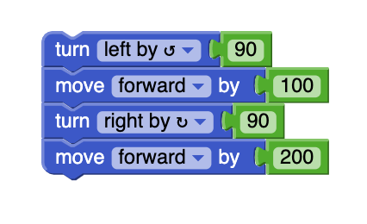
Notes:
Ask the class to read though the block coding code on the right; explain that when we ‘read’ coding we read downwards.
Can your students predict where the rocket will go?
Your students can either trace the code with a pencil or wipe board (if you have laminated it) or have a cut out rocket which they can physically move on the sheet.
You will need to explain that the ’100’ equals the same size as one square of the grid.
You were also need to explain that 90 means a 90 degree/right/left turn.

Slide 11
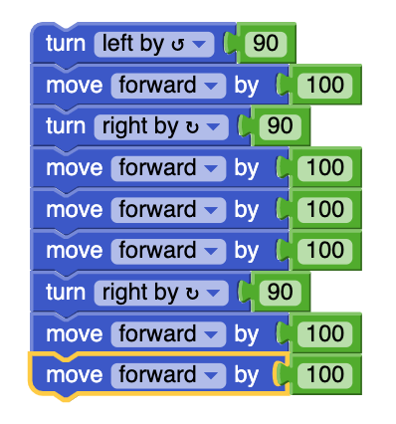
Notes:
Ask the class to read though the block coding code on the right; explain that when we ‘read’ coding we read downwards.
Can your students predict where the rocket will go?
Your students can either trace the code with a pencil or wipe board (if you have laminated it) or have a cut out rocket which they can physically move on the sheet.
You will need to explain that the ’100’ equals the same size as one square of the grid.
You were also need to explain that 90 means a 90 degree/right/left turn.

Slide 12
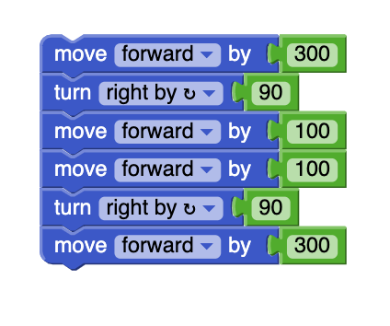
Notes:
Ask the class to read though the block coding code on the right; explain that when we ‘read’ coding we read downwards.
Can your students predict where the rocket will go?
Your students can either trace the code with a pencil or wipe board (if you have laminated it) or have a cut out rocket which they can physically move on the sheet.
You will need to explain that the ’100’ equals the same size as one square of the grid.
You were also need to explain that 90 means a 90 degree/right/left turn.

